Slide 1
Agent Prediction in Narrative Text
Mica Haney
Ross Newman
Dhana Sanketha
Varunraj

Slide 2
Results - Builder
Accuracies
SVM: 0.5096427442301612
NB: 0.9848245336705659
MLP: 0.989883022447044
Tree: 0.9807145115396775
Trained on 78 books.
SVM: Rbf kernel w/ balanced class weights.
Doing hyperparameter tuning
Maybe feature engineering - multiplication

Slide 3
The Goal
To predict the protagonist and antagonist of a narrative text.
There was neither the time nor the results to attempt the extended goal of analyzing the relationship between the protagonist and the antagonist.

Slide 4
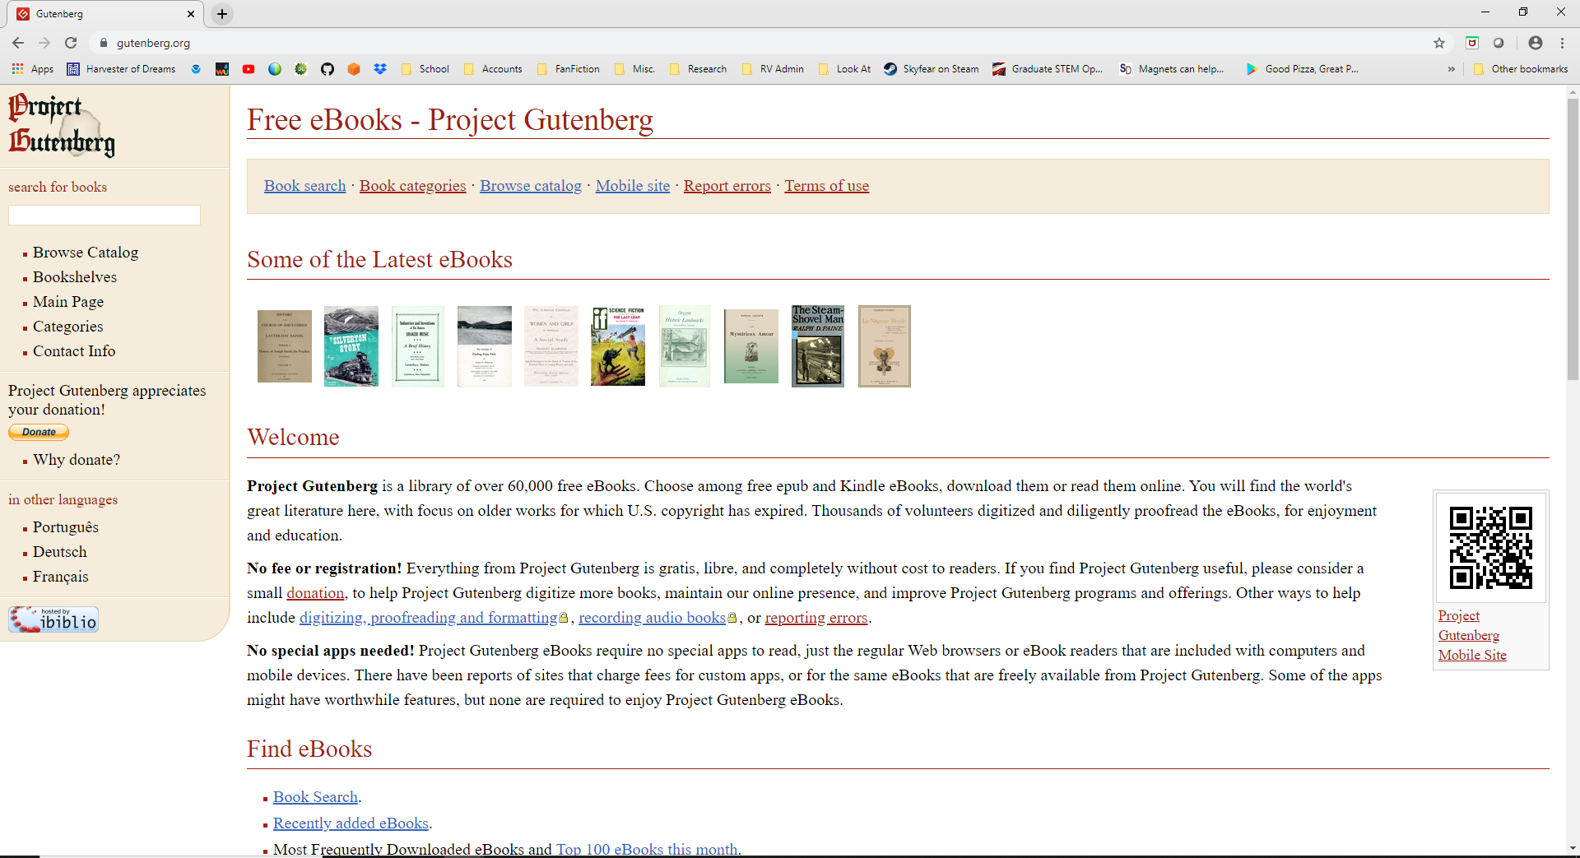
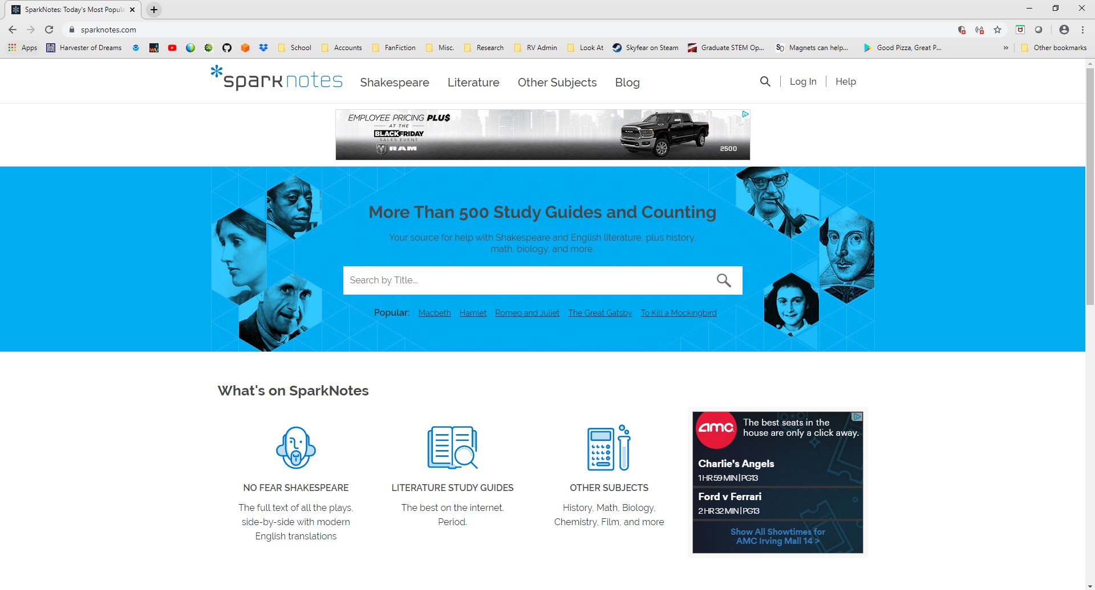
The Data
The narrative texts were retrieved from Project Gutenberg (https://www.gutenberg.org/, top figure). The protagonists and antagonists for all texts were retrieved from SparkNotes (https://www.sparknotes.com/, bottom figure).
The first roadblock: our attempts at data scraping resulted in IP banning. All data was collected by hand. This led to significantly less data than we thought we’d have.

Slide 5
First Layer: Data Processing
Each document was processed to retrieve features from the text. Why? Because while text is a goldmine of information, it’s unstructured. A lot of digging is necessary to retrieve it.
In this model two features were generated: coreference counts and sentiment scores.

Slide 6
First Layer: Data Processing - Coreference
Retrieved by first getting the part-of-speech tags, then finding all of the named entities (people, places, organizations, etc.). Then, find all of the named objects that reference the same thing, and count the number of times that named entity is referenced.
Coreference resolution was done using the spaCy and neuralcoref python packages.

Slide 7
First Layer: Data Processing - Sentiment
Sentiment analysis is the evaluation of a piece of text and assigning it a sentiment score. The score normally used is positive/negative, and is what we’ve applied.
For each document, each named entity has every sentence that it is mentioned in scored for sentiment, and the sentiment score averaged. This give a rough idea of if the text surrounding a named entity is generally positive or negative.
Sentiment analysis was done using nltk and vader python packages.

Slide 8
Why Are We Using Packages?
The described techniques are machine learning models in and of themselves. We use pre-trained models because the amount of time, effort, and expense involved in creating new models is paper-worthy, and not the focus of our project.

Slide 9
Second Layer: Models
We tried four different models, each attempting to classify each named entity as either the protagonist, antagonist, or neither. They were evaluated based on the accuracy of the predictions.
SVM: 51.0% Naive Bayes: 98.5% Multilayer Perceptron: 99.0% Decision Tree: 98.1%

Slide 10
Second Layer: Models
That looks great! However, there was an issue.
The models were classifying everything as being neither a protagonist nor an antagonist.
Our solution was to alter the class weights. The weights for the SVM were set to balanced, which improved accuracy.

Slide 11
Hyperparameter Tuning
The next step was to try hyperparameter tuning. For each model, sci-kit learn’s GridSearchCV method was applied.

Slide 12
Final Results
The best model was the MultiLayer Perceptron, with parameters of Alpha=1e-5, Hidden Layer Size=14.
 | Precision | Recall | F1-Score | Support
Antagonist | 0.00 | 0.00 | 0.00 | 19
Neither | 0.99 | 1.00 | 1.00 | 3025
Protagonist | 0.83 | 0.33 | 0.48 | 15
Accuracy |  |  | 0.99 | 3059
Macro AVG | 0.61 | 0.44 | 0.49 | 3059
Weighted AVG | 0.98 | 0.99 | 0.99 | 3059

Slide 13
Final Results
The best model for identifying antagonists was the SVM, with parameters of C=10, Gamma =0.01.
 | Precision | Recall | F1-Score | Support
Antagonist | 0.15 | 0.16 | 0.15 | 19
Neither | 0.99 | 1.00 | 1.00 | 3025
Protagonist | 0.45 | 0.33 | 0.38 | 15
Accuracy |  |  | 0.98 | 3059
Macro AVG | 0.53 | 0.49 | 0.51 | 3059
Weighted AVG | 0.98 | 0.98 | 0.98 | 3059

Slide 14
Code
Code Link:
https://colab.research.google.com/drive/1wnW3DnkmYyaMBDulwHgLQA8FfGwWLfUI
All data, code and pre-trained models can be found at our Github repo:
https://github.com/rcnewman/agent-prediction-ml-finalproject

Slide 15
References and Resources
https://www.gutenberg.org/
https://www.sparknotes.com/

